Slide 1
Crop classification using deep learning
Team Members Group:81 Panel Number:16
Project Advisor: Dr.S.Padmavathi, Associate Professor(SG) , Department of CSE
SNo | Reg.No | Name of the Student | Section
1 | CB.EN.U4CSE18101 | AADHITH S. | CSE B
2 | CB.EN.U4CSE18118 | HAREESH V. | CSE B
3 | CB.EN.U4CSE18163 | VIGNESH H. | CSE B
4 | CB.EN.U4CSE18173 | THARUN KUMAR A. | CSE B

Slide 2
Problem Definition
Crop identification using deep learning
Develop a web application that can identify crops using the image of it's leaf with the help of a Machine Learning model. The application will allow users to either upload or take new image of the leaf.

Slide 3
Previous Review Comments and Actions Taken (in points)
Validation of the work with suitable metrices is required.
We have used four metrics of evaluation in order to evaluate the performance of classifiers: Accuracy score, F1 score, Precision score and Mean Squared Error.
Hyperparameter tuning of the model is required.
We have used the Validation data set to parameter tune the various Machine learning and Deep learning model.
Comparison with pre-trained architectures or feature extraction methods are recommended.
Various features are extracted as .csv file from the input image, required pre-processing are done, trained and tested with various ML classification models like SVM, Random Forest, Logistic Regressor, XG Boost, ADA Boost, Bagging Classifier, and Naïve Bayes Classifier.

Slide 4
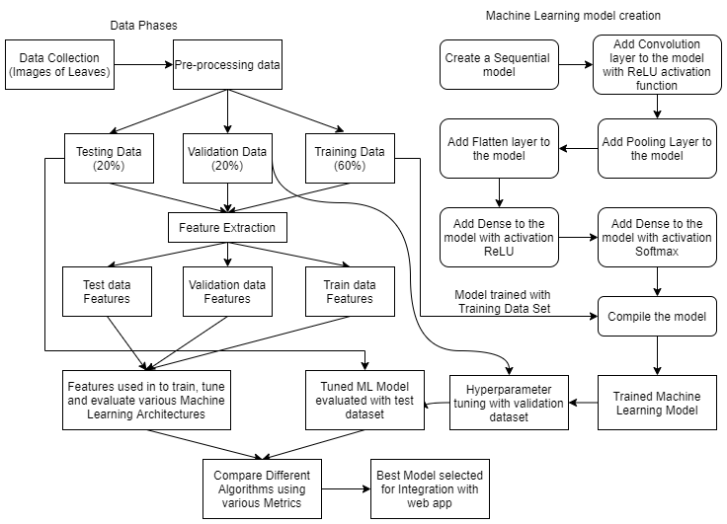
Architecture Diagram

Slide 5
Explanation of Architecture diagram ( in points)
The dataset of various plant images are collected.
Required pre-processing of the images are done.
Data is split into train-validate-test data in the ratio of 60:20:20.
Features are extracted as a .csv file from the train, test and validate dataset.
The CNN model is created and trained using the training dataset.
The trained model is then hyper parameter tuned using the validation dataset to increase its accuracy of classification.
Then test dataset is used to evaluate the model’s performance using different metrics of performance evaluation.
The training dataset features generated as .csv file is used to train the various other machine learning architectures/models.
The validation dataset features is used to parameter tune the various models to increase its accuracy of classification.
The testing dataset features is used to evaluate the model’s performance.
Finally the various machine learning architectures and the CNN model all are compared by various metrics and the best model is selected as the final model for classification which is integrated with the web-app to give insights on the crops.

Slide 6
List all the Modules ( of the proposed Project )
Module 1: Data collection and Pre-processing.
Module 2: Feature Extraction.
Module 3: CNN Model Creation.
Module 4: Training and Testing various Machine Learning Algorithms
Module 5: Choosing the Best Classification Algorithm.

Slide 7
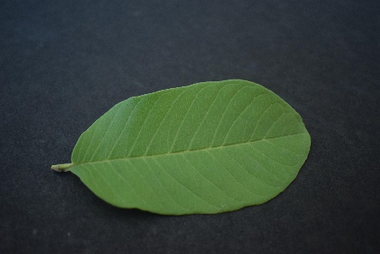
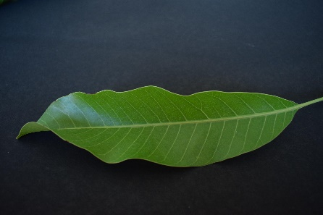
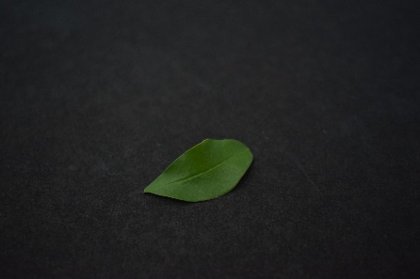
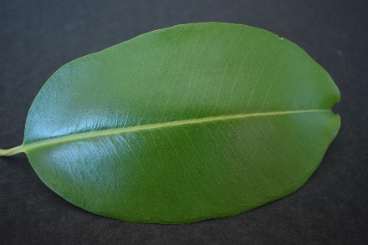
Module 1- Data Collection and Pre-processing
The first module is the data collection phase of various plant images.
Dataset Link: https://data.mendeley.com/datasets/hb74ynkjcn/1
Sample Images
Guava
Mango
Pomegranate
Jamun
After data collection, various pre-processing is done to the images like background removal, normalizing the size of input data, after feature extraction using Standard Scaling, removing uncorrelated columns and unnecessary columns.

Slide 8
Module 1- Data Collection and Pre-processing
Background Removal:
We use the cv2 module of python to remove the background and take only the leaf into consideration.
Resize images to same Resolution:
Images of 6000*4000 when given as input to CNN take longer time. So we normalize and resize the images to 600*400 using the PIL module.
Standard Scaling:
Standard scalar is used to normalize the range of independent variables or features of data after the features are extracted as .csv file from the images.
Remove Unnecessary Attributes:
After features extraction into .csv file, some of the attributes have very low values also the correlation value of such attributes with the target variable is very low. So taking only attributes that are correlated with the target variable and dropping the unnecessary attributes/columns.

Slide 9
Module 2- Feature Extraction
After the pre-processing of images are done, the leaf images undergoes the following:
Image is converted into greyscale image
Then converted to binarized image
After these processes, the various features are extracted from the image and stored in a .csv file.
Features: 'eccentricity’, 'extent’,
'moments_hu-0', 'moments_hu-1’,
'moments_hu-2', 'euler_number’,
'mean_intensity', 'std_intensity’,
'25th Percentile', '75th Percentile’,
'iqr’.
These are the 11 features that are extracted from the images.

Slide 10
Module 3- CNN Model Creation
Simple and easy to create a Sequential model. Creating a sequential model where different layers are stacked on top of one another.
Convolutional Layer where filter learn and recognize features within images.
Activation Layer to help network learn complex patterns in data.
Pooling Layer where down-sampling takes place to reduce the dimensions of the feature map thereby number of computations in the network is reduced.
Flatten Layer flattens the multi-dimensional input tensors into a single dimension.
Dense Layer each neuron receives input from all the neurons of previous layer. Softmax activation function used in this layer is used for multiclass classification problems.

Slide 11
Module 3- CNN Model Creation
Compiling the model which defines the loss function to find errors\deviation in the learning process, optimizer to optimize the input weights and the metrics to evaluate the performance of the model.
After training the model using training dataset, hyper parameter tuning is done with the validation dataset to improve the classification accuracy of the model.
Then, the model is tested with the testing data set and evaluated using various evaluation metrics like Accuracy, F1 Score, Precision Score and Mean Squared Error.

Slide 12
Module 4 - Training and Testing various Machine Learning Algorithms
In order to compare and contrast our model with various classification models, we chose to train and test various algorithms like:
Naive Bayes Classifier
Random Forest Regressor
Logistic Regressor
Bagging Algorithm
XG Boost Classifier
ADA Boost Classifier
Support Vector Machine

Slide 13
Module 4 - Training and Testing various Machine Learning Algorithms
The features generated from the input images of train, test and validate data are stored in .csv files.
The training features .csv file dataset is used to train the various classifiers/ML models.
The validation features .csv file dataset is used to parameter tune the classifiers to improve the classification accuracies of various classifiers/ML models.
The testing features .csv file dataset is used to evaluate the classifiers’ classification performance using various evaluation metrics.

Slide 14
Module 5 – Choosing the best Classification Algorithm
We have chosen four metrics of evaluation to evaluate the classifiers.
The various Machine Learning algorithms are trained, tested, the metrics are evaluated and compared below:
ML Architecture | Mean Squared Error | Accuracy Score | F1 Score | Precision Score
XGB Classifier | 0.122 | 0.935 | 0.935 | 0.936
Random Forest | 0.188 | 0.729 | 0.724 | 0.791
Ada Boost Classifier | 0.606 | 0.761 | 0.735 | 0.781
Bagging | 0.116 | 0.941 | 0.941 | 0.942
Naïve Bayes | 0.896 | 0.677 | 0.673 | 0.687
SVM | 1.070 | 0.548 | 0.529 | 0.633
Logistic Regressor | 0.851 | 0.574 | 0.556 | 0.655
CNN models' Accuracy score is: 0.87

Slide 15
Module 5 – Choosing the best Classification Algorithm
Running time including preprocessing:
Bagging - 5.61 sec
AdaBoost - 5.45 sec
XG Boost -8.14 sec
Random Forest - 6.16 sec
Naive Bayes - 5.34 sec
SVM - 5.44 sec
Logistic Regression - 5.47 sec
On comparing all the Machine Learning models, Bagging outperformed well with higher accuracy, less error and better metrics with less time.
Metrics after tuning the Bagging model:
"The models' mean squared error is: 0.103",
"The models' Accuracy score is: 0.955",
"The models' f1 score is: 0.955",
"The models' Precision score is: 0.955“
By using decision tree as base classifier, n_estimators being 101 and random states being 14.

Slide 16
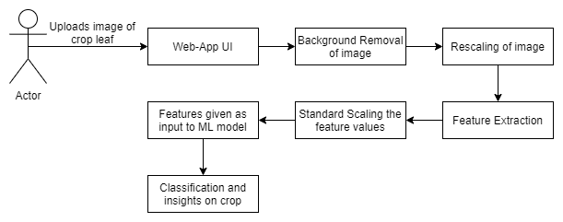
User end interaction

Slide 17
CONCLUSION
We studied various machine learning and deep learning approaches to learn discriminative features from leaf images with classifiers for plant identification. From the experimental results, we justified that learning the features through skimage and using a bagging model with a decision tree as a base classifier provides better results compared to other models. The observation of the performance of the model, when tested against a test dataset that had 4 different trees, was that it had an Accuracy of 95.6% and a mean squared error of 0.10, and the time taken to work in real-time is 5.61 sec. In future work, we will extend the work to recognize more species of trees.

Slide 18
References ( in IEEE format )
1.Wang, Xiao-Feng & Huang, De-Shuang & Du, Xiang & Xu, Huan & Heutte, Laurent. (2008). Classification of plant leaf images with complicated background. Applied Mathematics and Computation. 205. 916-926. 10.1016/j.amc.2008.05.108.
2.Wang, Bin & Brown, Douglas & Gao, Yongsheng & La Salle, John. (2013). Mobile plant leaf identification using smart-phones. 2013 IEEE International Conference on Image Processing, ICIP 2013 - Proceedings. 4417-4421. 10.1109/ICIP.2013.6738910.
3.Eid, Heba & Hassanien, Aboul Ella & Kim, Tai-Hoon. (2015). Leaf Plant Identification System Based on Hidden Naive Bays Classifier. 4th International Conference on Advanced Information Technology and Sensor Application (AITS), IEEE,Harbin, China. 10.1109/AITS.2015.28.
4.S. H. Lee, C. S. Chan, P. Wilkin and P. Remagnino, "Deep-plant: Plant identification with convolutional neural networks," 2015 IEEE International Conference on Image Processing (ICIP), 2015, pp. 452-456, doi: 10.1109/ICIP.2015.7350839.

Slide 19
References ( in IEEE format )
5.B. K. Varghese, A. Augustine, J. M. Babu, D. Sunny and S. Cherian, "INFOPLANT: Plant Recognition using Convolutional Neural Networks," 2020 Fourth International Conference on Computing Methodologies and Communication (ICCMC), 2020, pp. 800-807, doi: 10.1109/ICCMC48092.2020.ICCMC-000149.
6.S. Dave and K. Runtz, "Image processing methods for identifying species of plants," IEEE WESCANEX 95. Communications, Power, and Computing. Conference Proceedings, 1995, pp. 403-408 vol.2, doi: 10.1109/WESCAN.1995.494064.
7.L. Zhang, J. Kong, X. Zeng and J. Ren, "Plant Species Identification Based on Neural Network," 2008 Fourth International Conference on Natural Computation, 2008, pp. 90-94, doi: 10.1109/ICNC.2008.253.
8.Grinblat, Guillermo & Uzal, Lucas & Larese, Monica & Granitto, Pablo. (2016). Deep learning for plant identification using vein morphological patterns. Computers and Electronics in Agriculture. 127. 418-424. 10.1016/j.compag.2016.07.003.

Slide 20
THANK YOU

